Slide 1
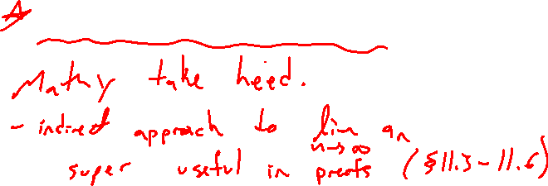
Section 11.1 Sequences
Lecture 3
Montone Convergence Theorem

Slide 2
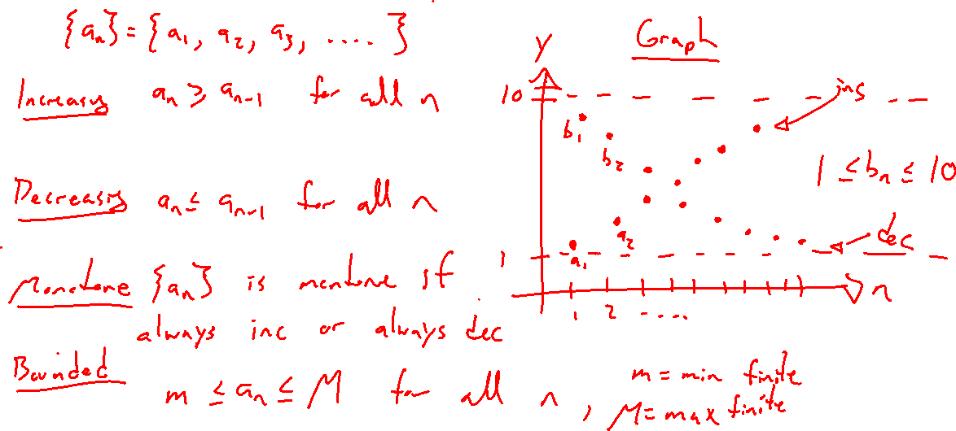
Increasing, Decreasing, Monotone, Bounded
Notes:
Pictures, careful definitions.

Slide 3
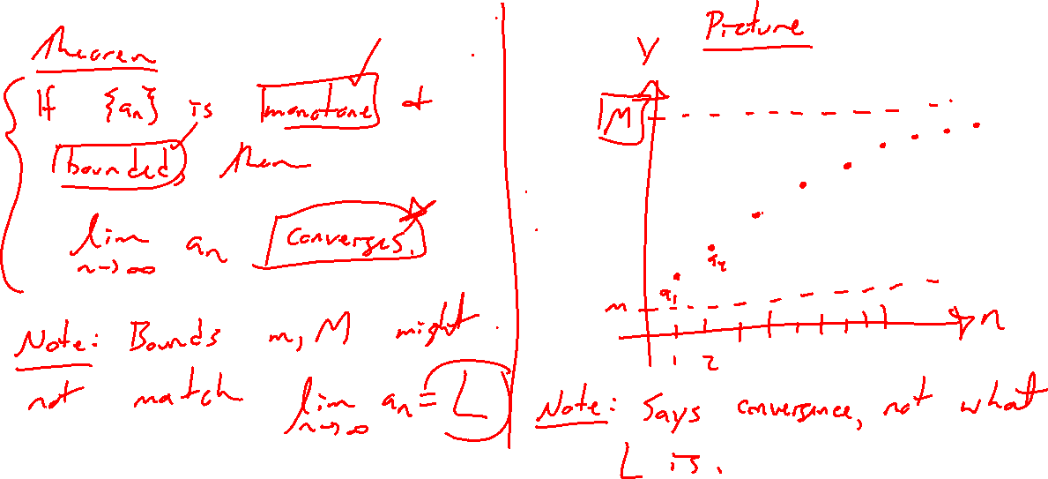
Monotone Convergence Theorem Idea
Notes:
Intuition via graph
Theorem statement
Indirect technique for limit calculation
Super useful idea for proving many ideas of this chapter, mathy people care, students need not focus.

Slide 4
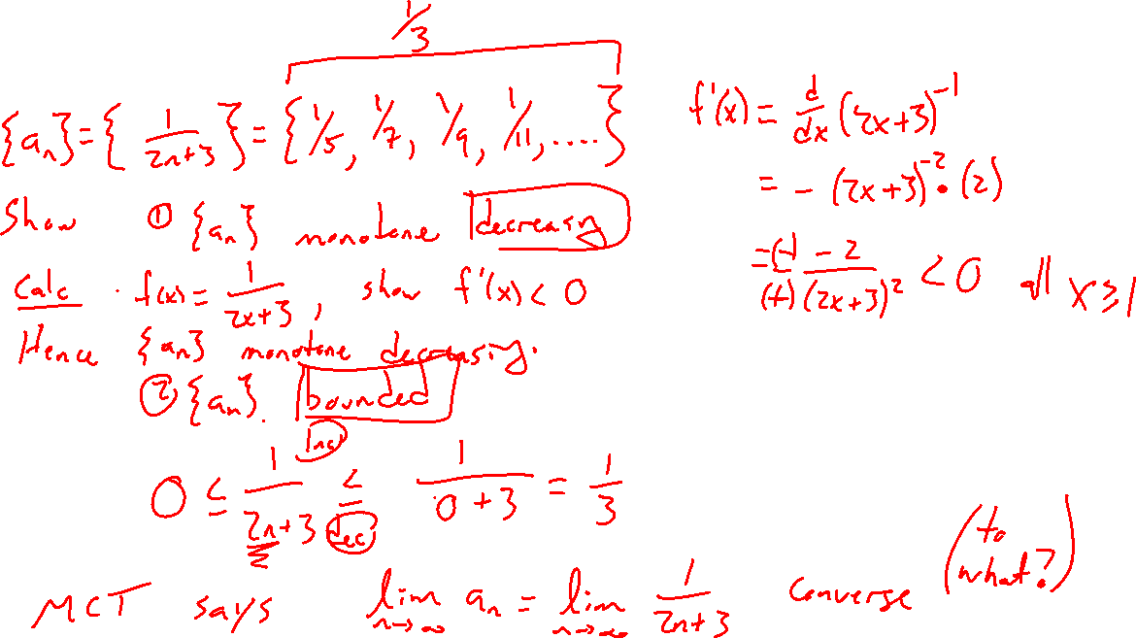
Example
Notes:
a_n = 1/(2n+3), use derivative to show decreasing

Slide 5
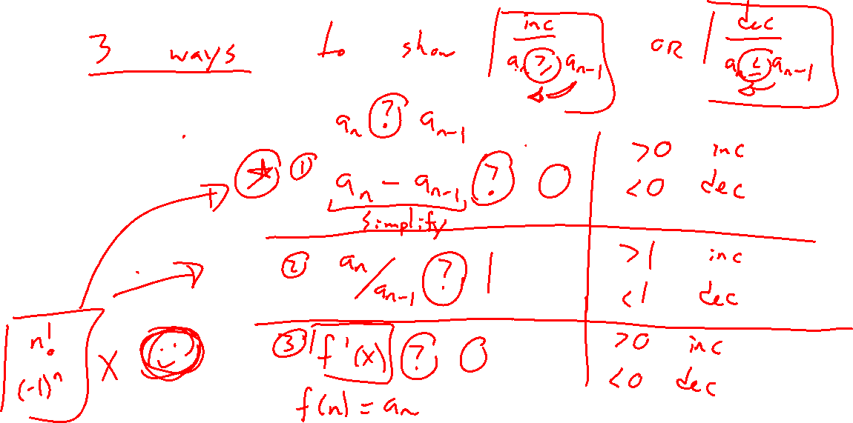
Ways to Show Increasing or Decreasing
Notes:
a_n – a_(n-1) ? 0
a_n / a_(n-1) ? 1
Deraivative

Slide 6
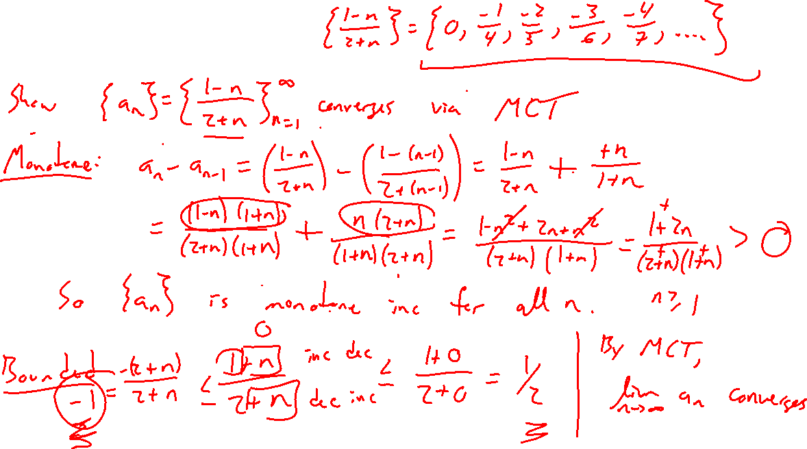
Fancier Example
Notes:
a_n = (1-n)/(2+n)

Slide 7
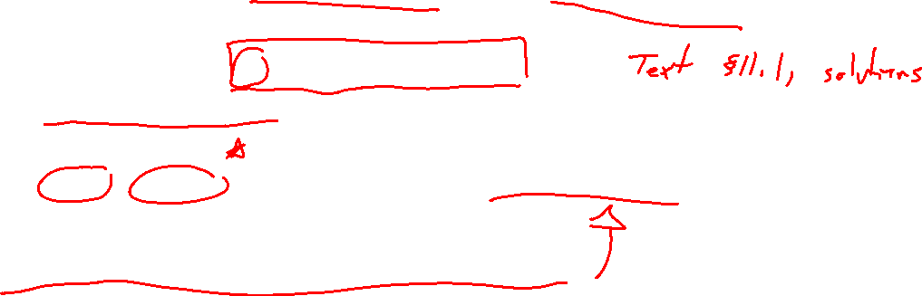
Section 11.1 Examples and Exercises
Rework examples 2, 4, 5, 6, 7, 8, 9, 13. Steps:
Write down problem
Attempt on own
Check / improve your answer against the text solution.
Exercises 3, 5, 11, 15, 23, 33, 35, 41, 55, 77

Slide 8

Section 11.1 Homework Submission to Canvas
Preview of section
Skim section, write short paragraph summary, list all important definitions / theorems / formulas.
Notes on video lectures
Include all details, worked examples, your own thoughts
Worked examples from text
Solutions to exercises
Final reflection of section
List of key takeaways to remember

